Slide 1
Team 7 Game Report
Mario DeLagarza
Scoot Flolid
John Daloni

Slide 2
Goals of Game
Survive the Enemy barrage and reach the exit
Destroy all enemies and an exit will appear
Enter the Exit to move to next level
Earn Points by Killing enemies faster
Time converted into points
Earn a high Score

Slide 3
Game World
2D Dungeon Crawler.
Square grid with Food and Soda items for bonus Points
Random amount of enemies
Generated Hero Character
Damagable walls, and Non Damaged walls for boundaries.

Slide 4
In-Game Characters
Player (Rogue)
Can move in any direction
Can attack zombies
Can pick up food and soda items
Can damage certain walls
Can Walk through the exit
Has initial Health
Obtains points
Enemies(Zombies)
Multiple Versions
Increased Health and Attack based on version
Attack Player Using AI
Able to take damage
Stop at obstacle
Unable to go through the exit
Can pick up food to take points from player

Slide 5
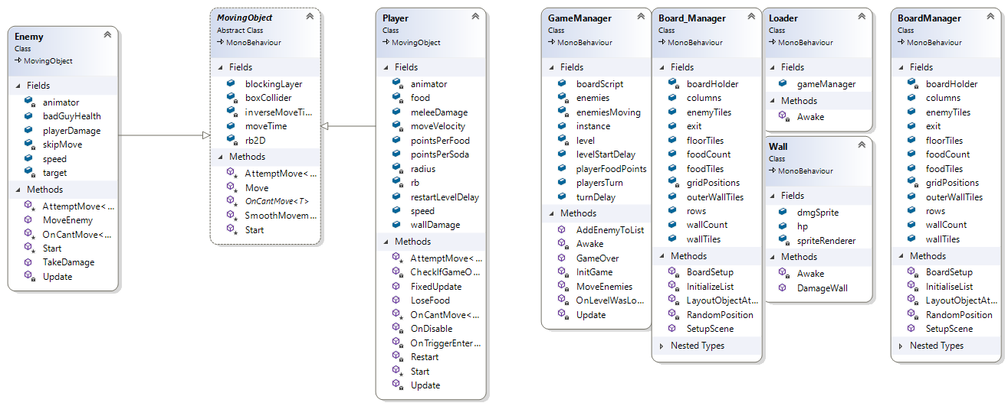
Class Diagram

